Slide 1
ADVANCED PACKAGE REWORK
SCORPION REWORK SYSTEM – PRODUCT OVERVIEW

Slide 2
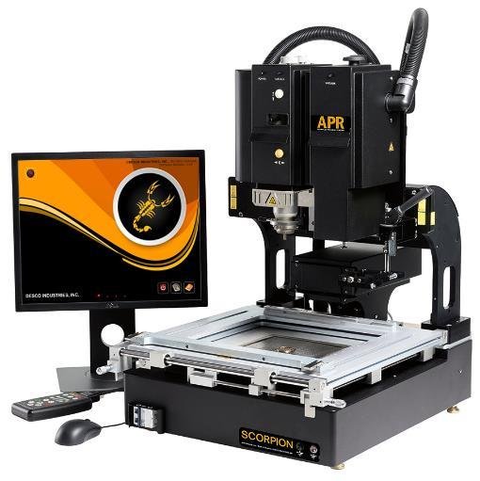
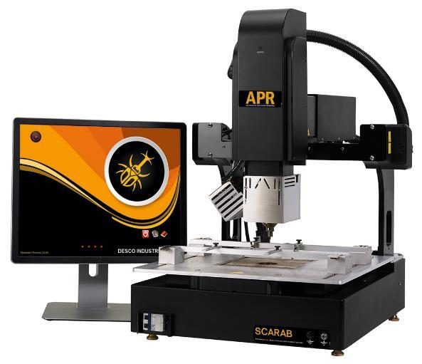
What Is APR?
DII brand for convection rework machines used to remove and install bottom terminated components such as BGA, QFN, and CGA

Slide 3
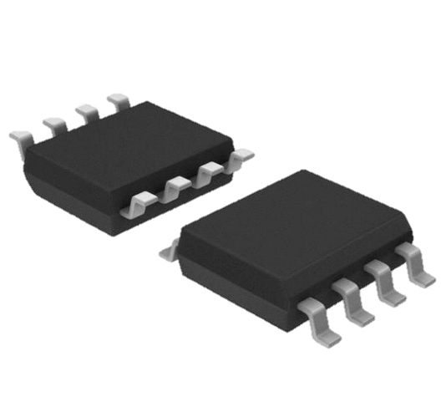
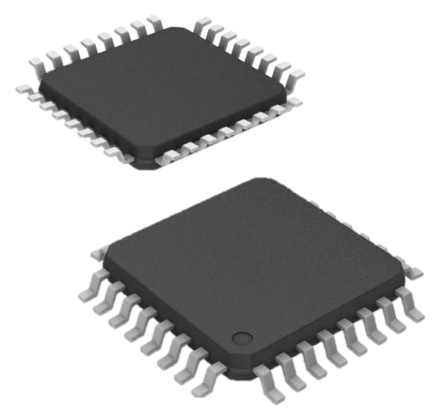
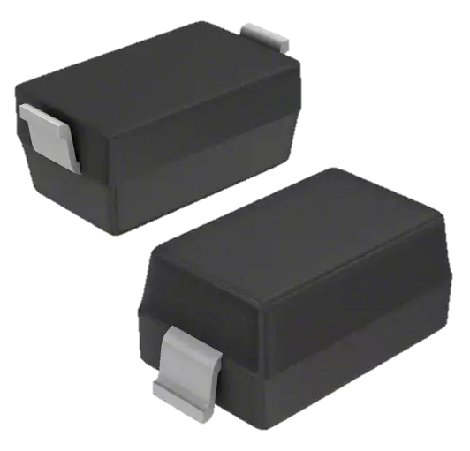
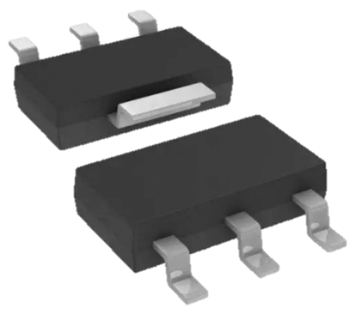
What Is It For?
Examples of SMD packages with leads
SOIC-8
TQFP
SOT-23-6
SOT-223

Slide 4
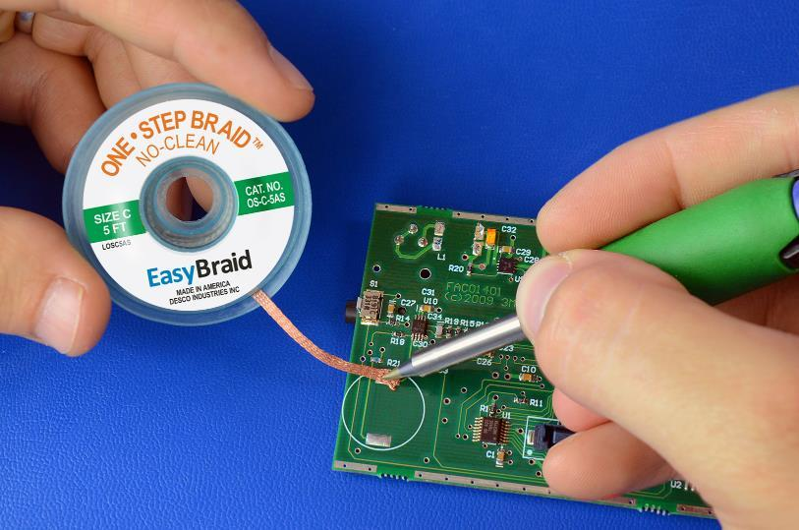
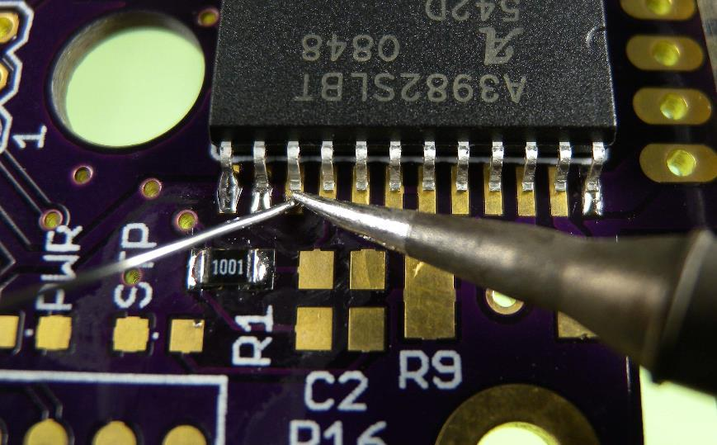
What Is It For?
SMD packages with leads can often be reworked by hand

Slide 5
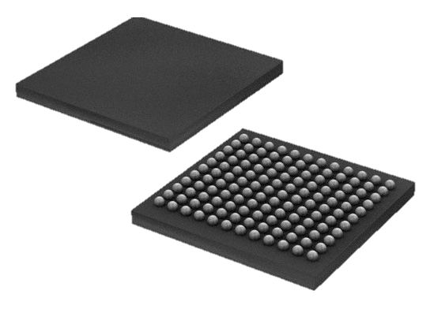
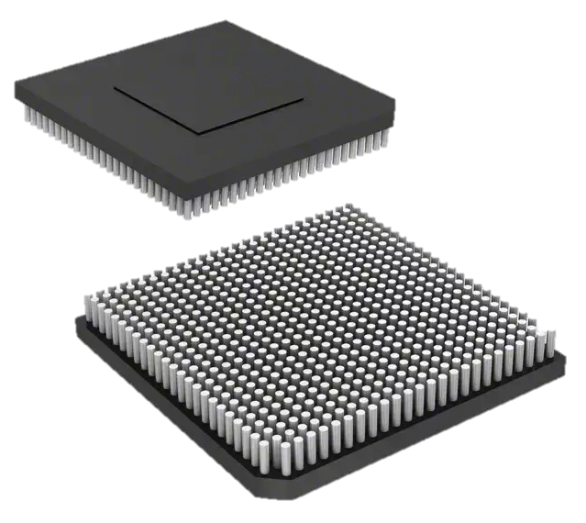
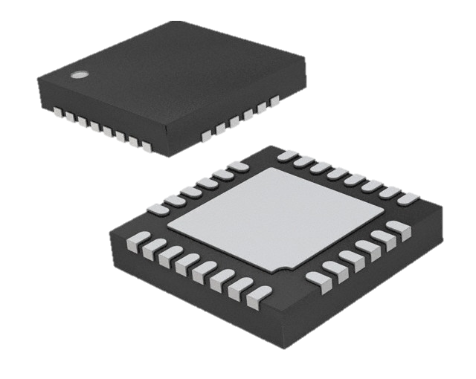
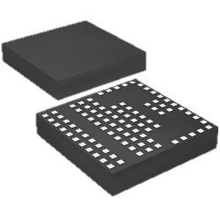
What Is It For?
Examples of SMD packages with bottom terminated leads
BGA
CGA
QFN
LGA

Slide 6
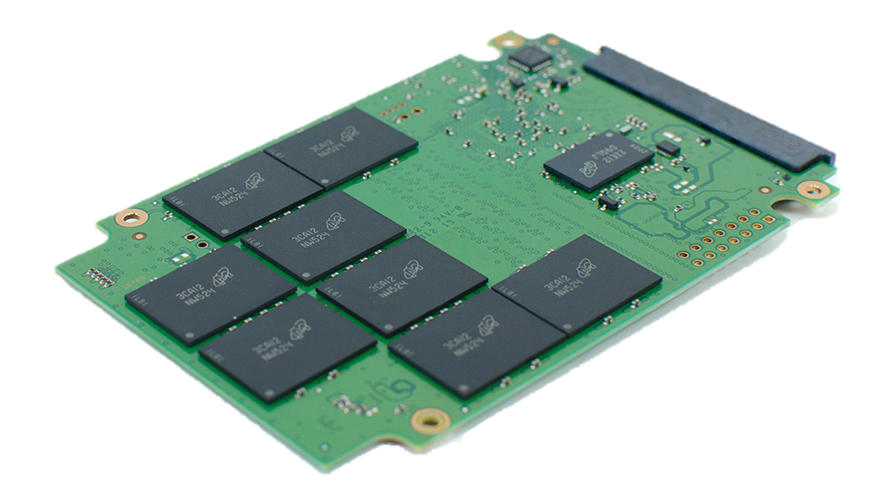
What Is It For?
How would you rework a board that looks like this?

Slide 7
Scorpion Rework System

Slide 8
Scorpion Rework System - Features
HARDWARE
550W Top Reflow Heater with Variable Airflow Focuses convection heat to the targeted component without reflowing other nearby parts
2800W Bottom Pre-Heater Dual-zone convection heating simultaneously warms a wide area of the PCB and a focused region directly underneath the targeted component

Slide 9
Scorpion Rework System - Features
HARDWARE
Workbench Sized System with 200-240VAC Voltage Input Encases the CPU, pumps and compressors into a single enclosure and operates with standard electrical systems
Embedded Linux CPU Spares the system from software bugs commonly created after Windows OS updates

Slide 10
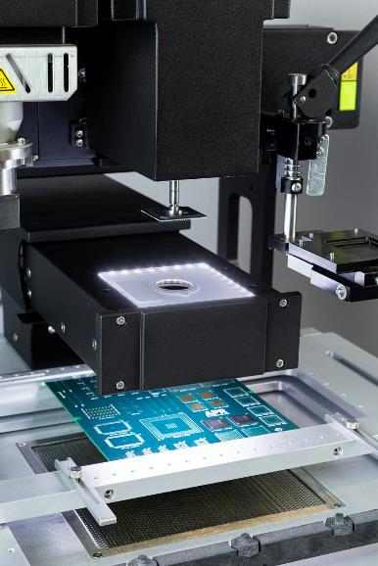
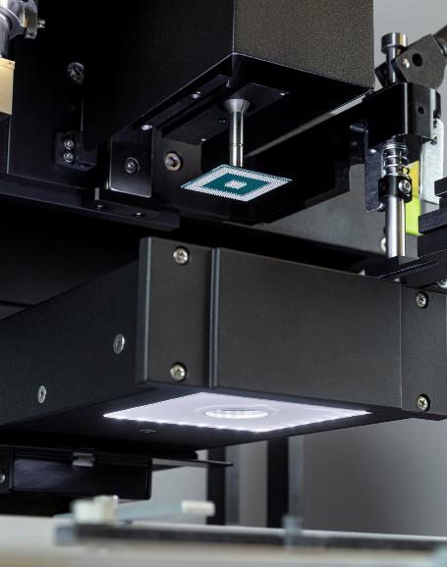
Scorpion Rework System - Features
CAMERA
Dual Camera Assembly Utilizes two cameras for improved optical alignment and less maintenance
Selectable Views for Top and Bottom Cameras Makes locating targeted components and landing pads easier

Slide 11
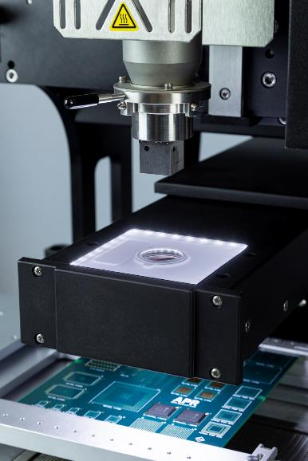
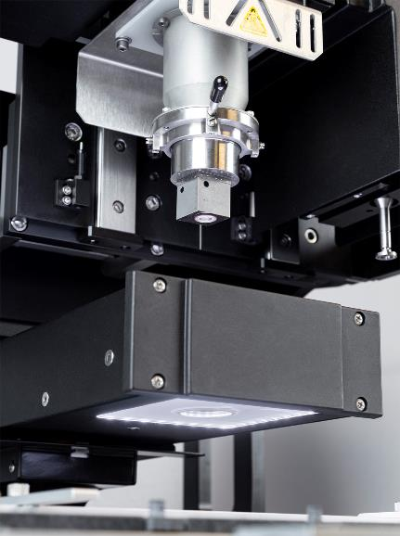
Scorpion Rework System - Features
CAMERA
Diffused LED Lighting Illuminates component terminals and landing pads without casting shadows
High Definition Zoom Levels Aides in the alignment of components with small dimensions or fine pitches

Slide 12
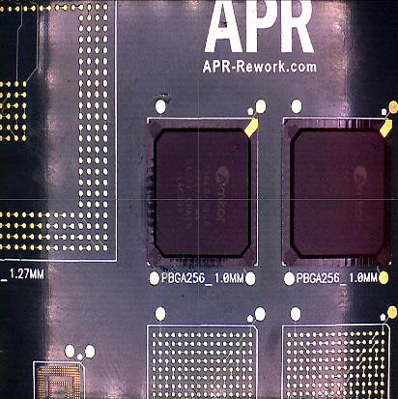
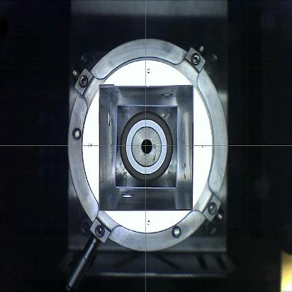
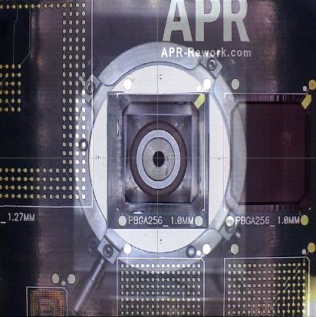
Scorpion Rework System - Features
CAMERA - REFLOW
Bottom Camera
Top Camera
Overlapped Image

Slide 13
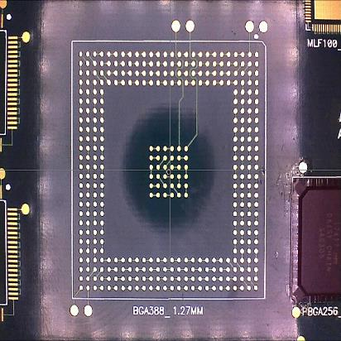
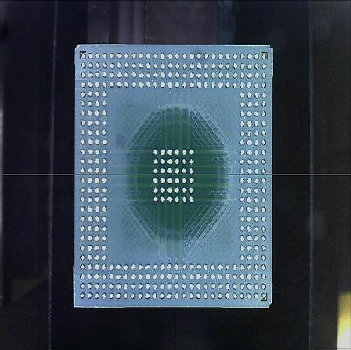
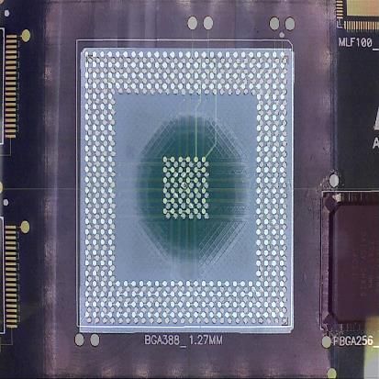
Scorpion Rework System - Features
CAMERA - PLACEMENT
Bottom Camera
Top Camera
Overlapped Image

Slide 14
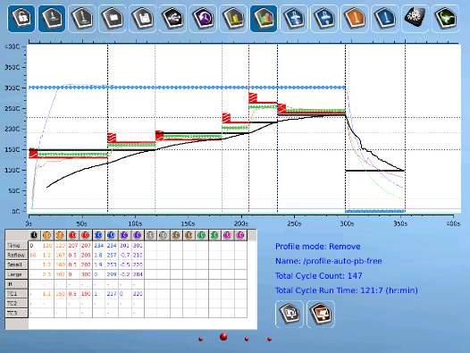
Scorpion Rework System - Features
SOFTWARE
On-the-Fly Thermal Profile Management with Live Solder Joint Temperature Display Enables operators to build successful thermal profiles in minimal attempts
Password Protected User Levels Protects saved thermal profiles from being modified by unqualified personnel
12 Different Language Settings Provides worldwide operator flexibility

Slide 15
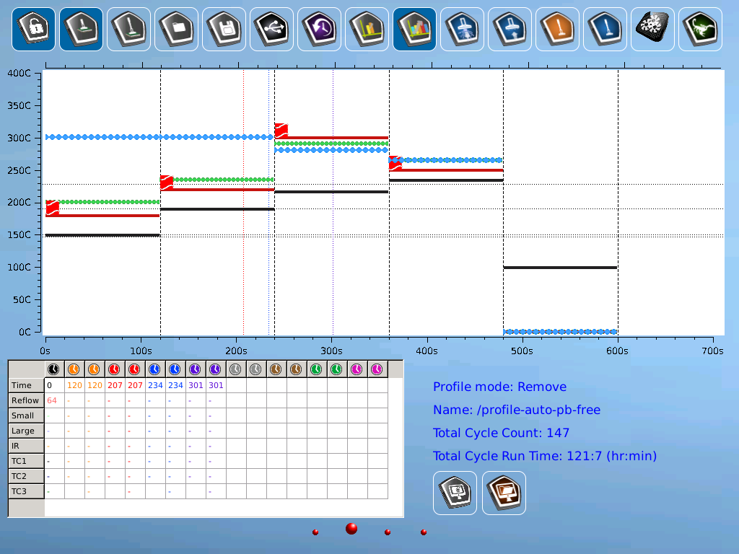

Slide 17
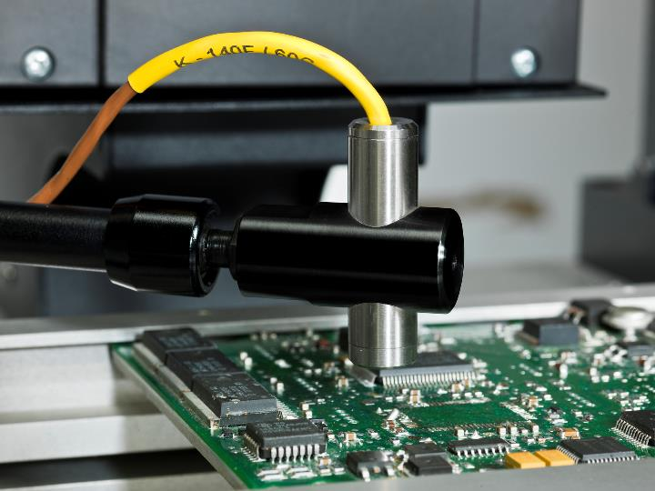
IR Pre-Heat Sensor Accessory
Item # APR-SRS-UK2
Sets a targeted pre-heat temperature for the PCB to reach prior to starting the thermal profile for consistent start temperatures no matter the environment

Slide 18
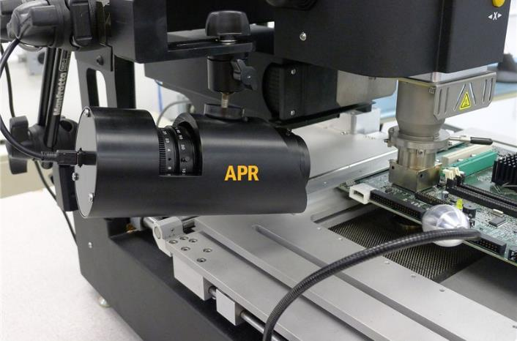
Side-View Camera Accessory
Item # APR-SRS-UK3
Aides the operator in building a successful thermal profile by providing a visual of the solder’s reflow
Outputs picture-in-picture display onto the Scorpion software – no need for a second monitor
Mounts to the Scorpion using a double articulated arm

Slide 19
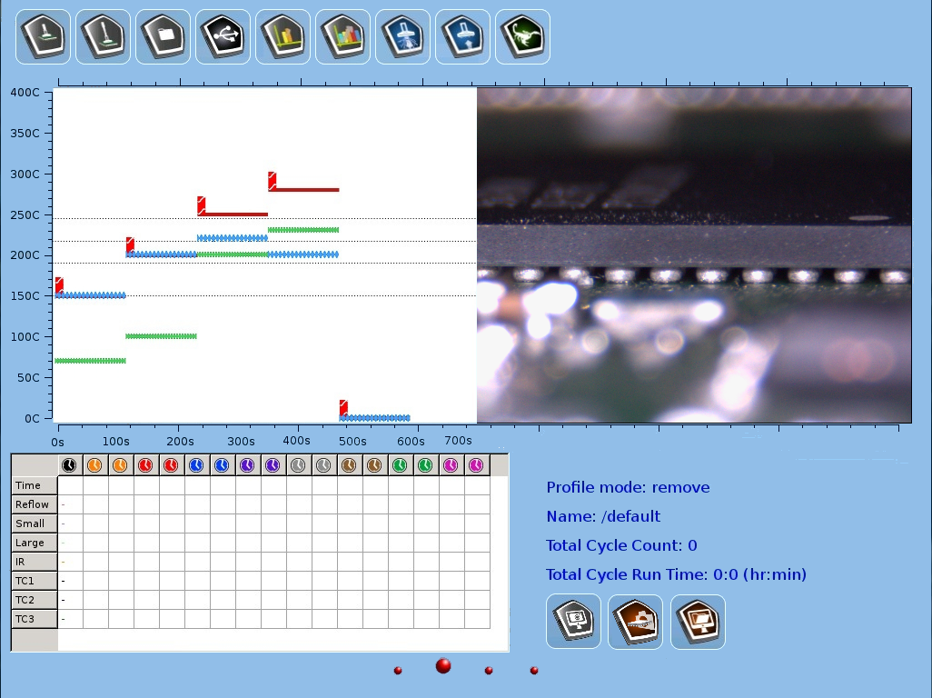

Slide 20
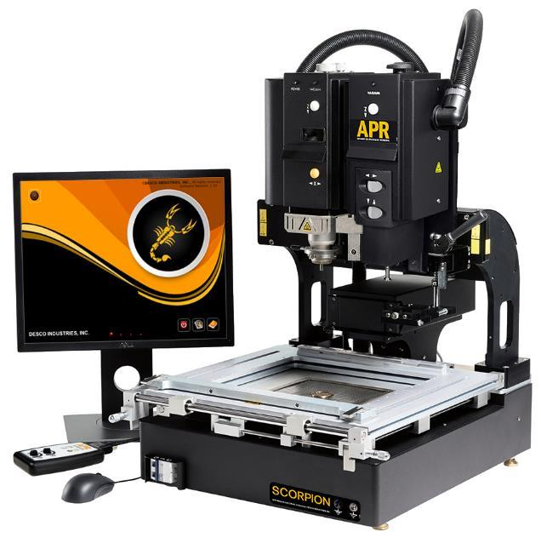
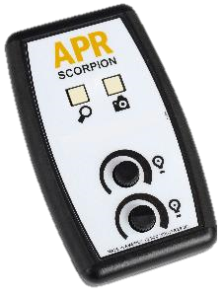
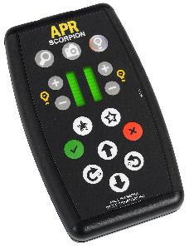
Scorpion Rework System – Models
APR-1200-SRS
Manual Placement Head
APR-1200A-SRS
Motorized Placement Head
Controller
Controller

Slide 21
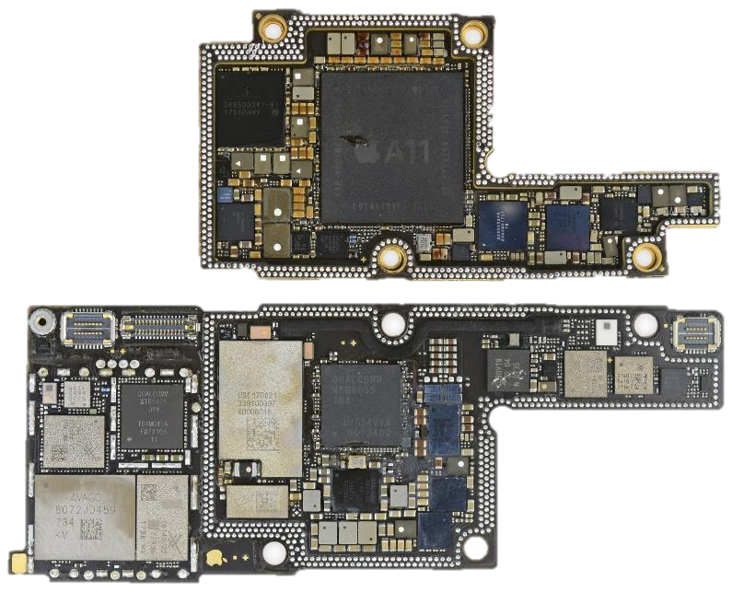
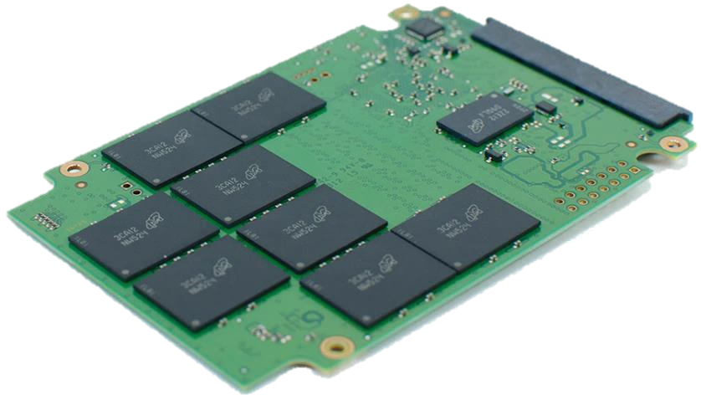
Scorpion Rework System – MOB Models
Common PCB
High Density PCB

Slide 22
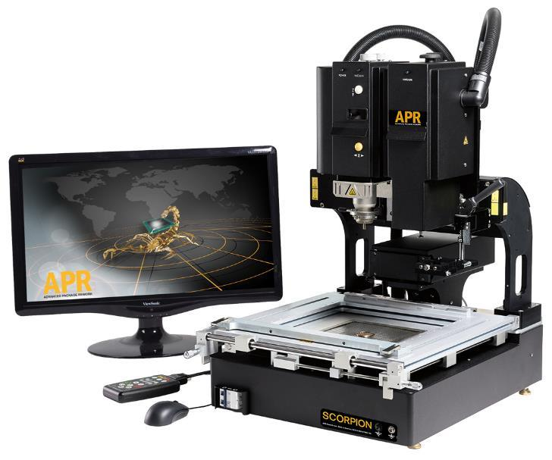
Scorpion Rework System – MOB Models
 | Standard Models | MOB Models
Camera Field-of-View | 45 mm x 57 mm | 25 mm x 25 mm
Camera Resolution | 720p + 1080p | 1080p
Max PCB Size | 343 mm x Open | 305 mm x Open
Monitor Size | 19 in. | 22 in.
APR-1200-SRS-MOB Manual Placement Head, for High Density PCBs
APR-1200A-SRS-MOB Motorized Placement Head, for High Density PCBs

Slide 23
Scorpion Selection Guide
 | APR-1200-SRS | APR-1200-SRS-MOB | APR-1200A-SRS | APR-1200A-SRS-MOB
Rework Application | Standard | High Density | Standard | High Density
Placement Head | Manual | Manual | Motorized | Motorized
Placement Force Sensor | No | No | Yes | Yes
Placement Accuracy | 0.0254 mm | 0.0254 mm | 0.0254 mm | 0.0254 mm
Minimum Component Size | 0.51 mm x 0.25 mm | 0.51 mm x 0.25 mm | 0.51 mm x 0.25 mm | 0.51 mm x 0.25 mm
Minimum Component Pitch | 0.3 mm | 0.3 mm | 0.3 mm | 0.3 mm
Max PCB Size | 343 mm x Open | 305 mm x Open | 343 mm x Open | 305 mm x Open
Max PCB Thickness | 6 mm | 6 mm | 6 mm | 6 mm
Camera Field-of-View | 45 mm x 57 mm | 25 mm x 25 mm | 45 mm x 57 mm | 25 mm x 25 mm
Camera Resolution | 720p + 1080p | 1080p | 720p + 1080p | 1080p
Monitor Size | 19 in. | 22 in. | 19 in. | 22 in.
Remote Control | Analog | Analog | Digital | Digital

Slide 24
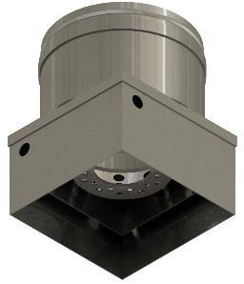
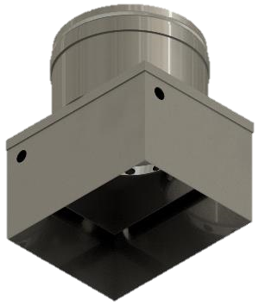
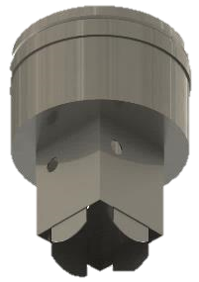
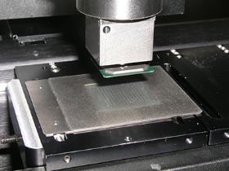
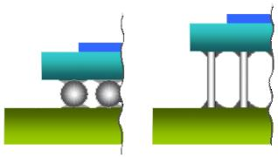
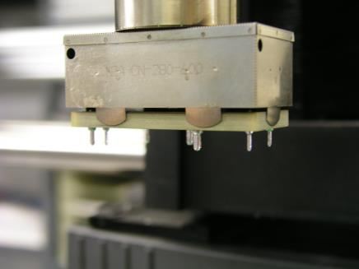
Tooling – Reflow Nozzles
Standard
for CGA
with Tweezers
BGA side-view
CGA side-view

Slide 25
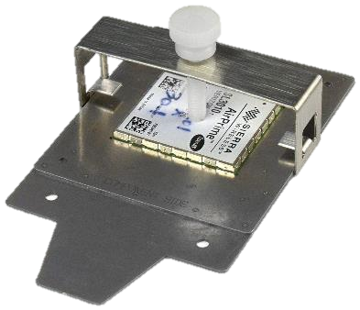
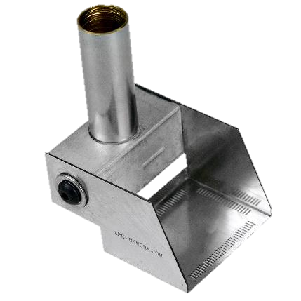
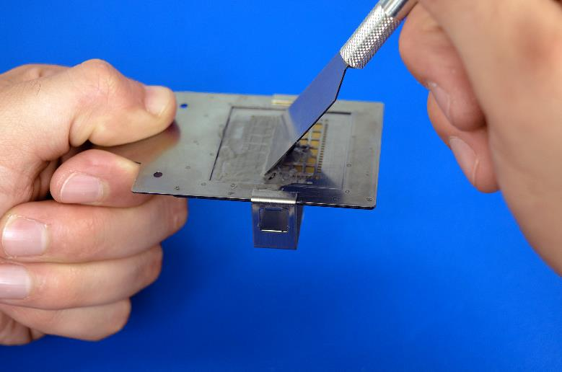
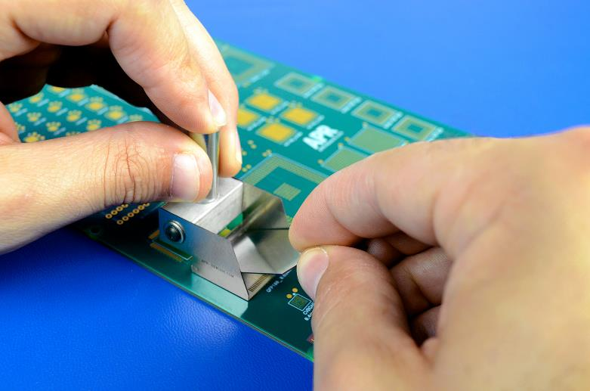
Tooling – Stencils
Component Print
Stencil
Flip-Up Stencil

Slide 26
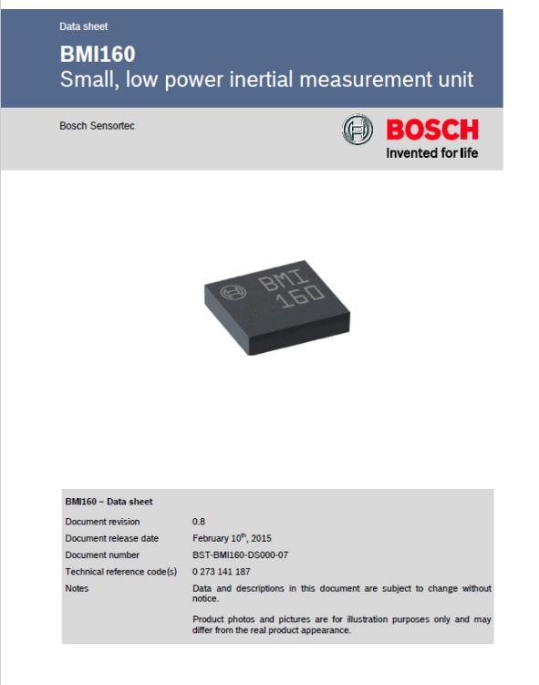
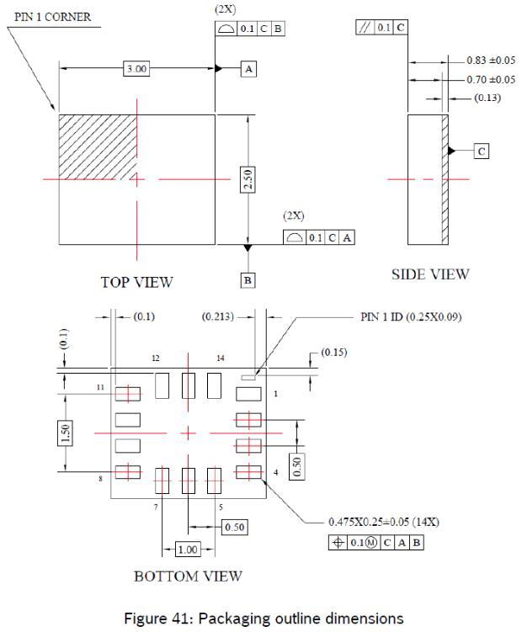
Tooling – What Info Do We Need?

Slide 27
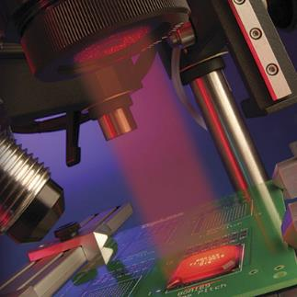
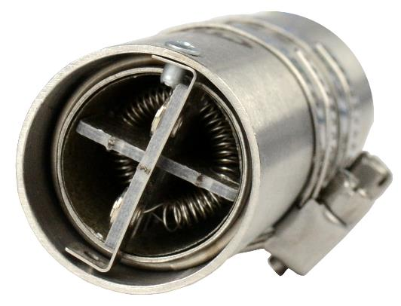
Rework Machine Technologies
Infrared Radiation (IR) Emits electromagnetic waves to heat the targeted object
Convection Emits hot air to heat the targeted object

Slide 28
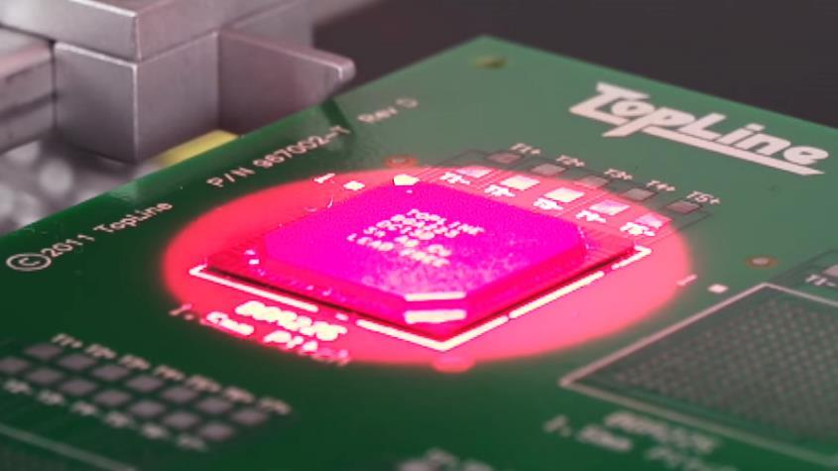
IR Disadvantages
Red light is generated through a lens and focused into a red dot that covers the targeted component
The red dot often heats adjacent components since its shape does not match the component

Slide 29
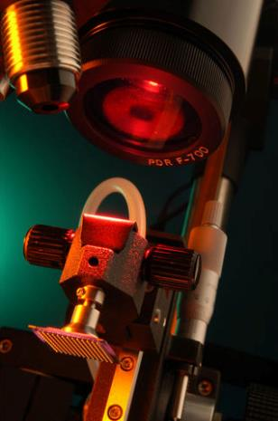
IR Disadvantages
Profiles have to be re-adjusted as the lamp deteriorates
The lamp and lens assembly can have short lifespans
Lenses cost $1,531 EA
Replacement bulbs cost $60 EA

Slide 30
IR Disadvantages
Emissivity – rate at which heat is absorbed into a material from an IR emitter
Black components have the highest emissivity
BGA with reflective dyes reflect IR heating differently than convection heating
IR heaters would not uniformly heat BGA chips like the one shown to the right

Slide 31
Convection Advantages
The same thermal profile will work no matter the component’s color; emissivity is not a factor
The preferred technology for reflow ovens in assembly lines
Convection heating is a more uniform heating method
Temperature across the complete PCB is more accurate and responsive

Slide 32
Technical Support
SERVICES OFFERED
Troubleshooting via e-mail and phone
On-site maintenance
CALIBRATION
Calibration is recommended annually
Calibration kits may be purchased or rented
On-site calibration service also available

Slide 33
Questions?
3651 Walnut Avenue
Chino, CA 91710 USA
(909) 664-9980
Service@APR-Rework.com

